Slide 1

ISDS 3105 – R programming T-TH 3.00–4.20 PM Room: 1835 BEC
Dario Bonaretti
Office Hours: T–TH 4.30–5.30 PM Room: 2400b BEC dbonar1@lsu.edu

Slide 2


Slide 3
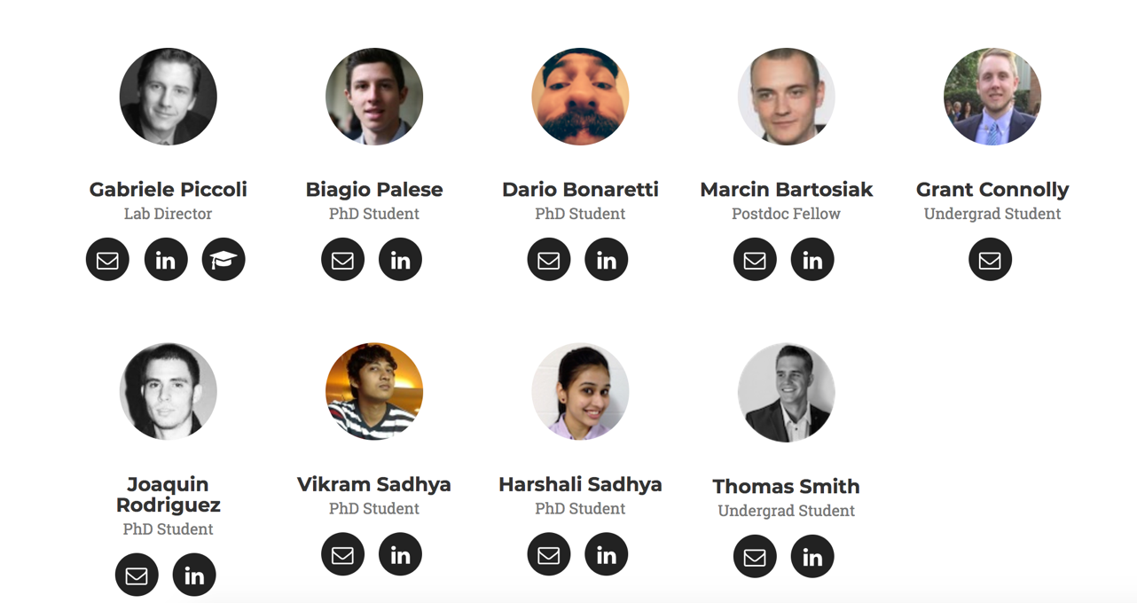

Slide 4
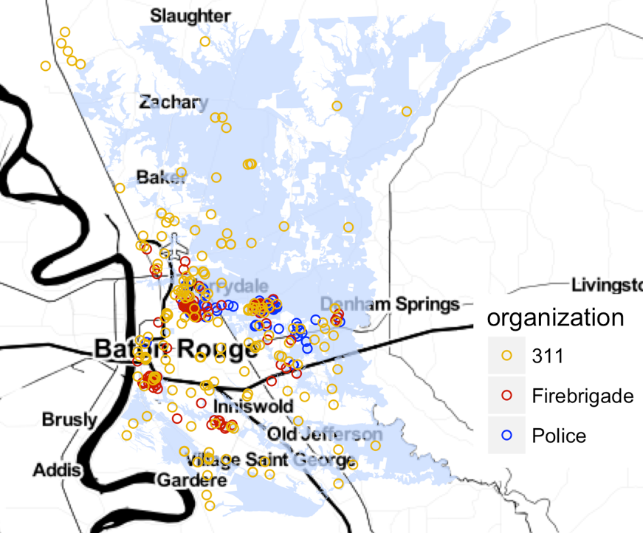
RESEARCH: Information Systems for Emergency Management

Slide 5
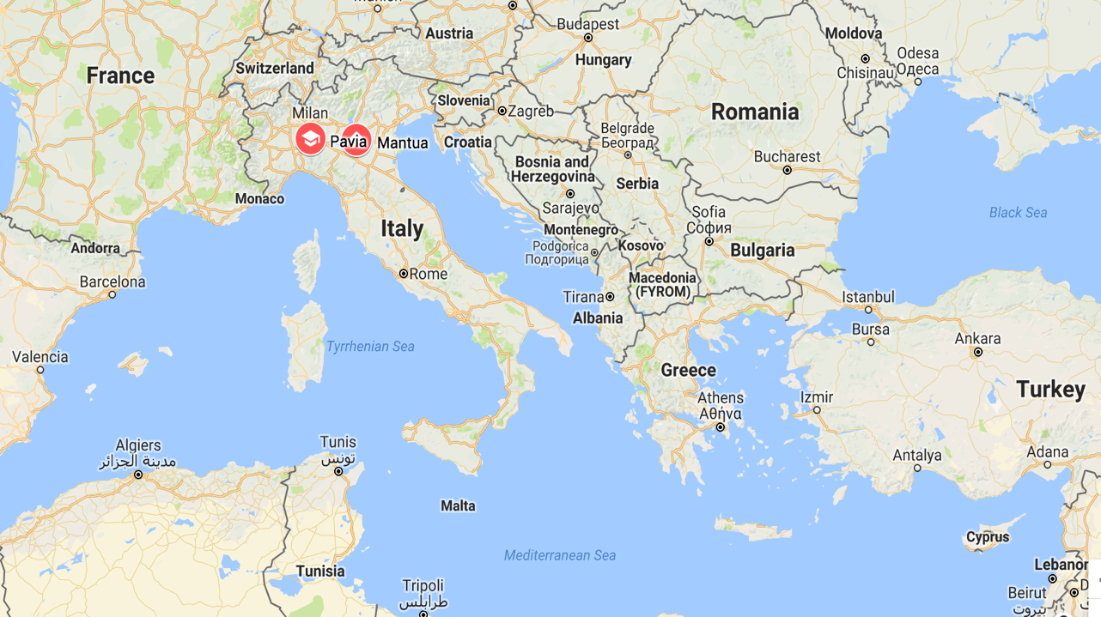

Slide 7
8.8 Feet 280 Pounds

Slide 11


Slide 12
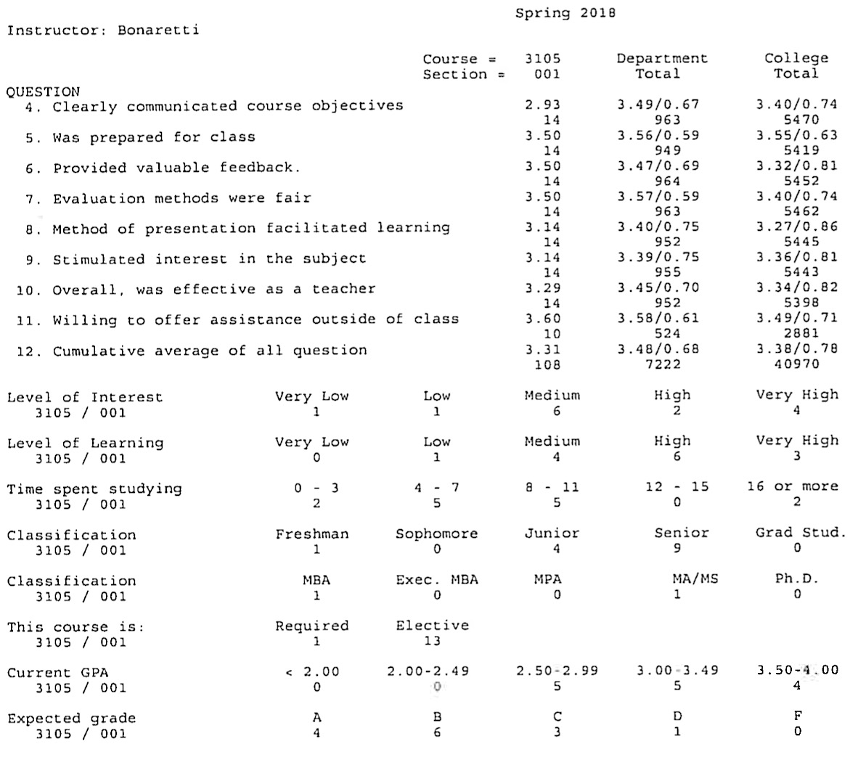

Slide 13
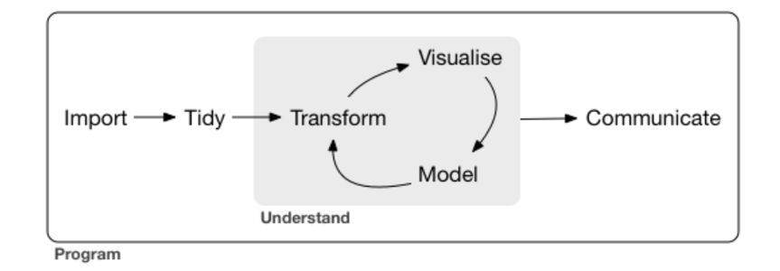
WHAT YOU WILL LEARN
From http://r4ds.had.co.nz/introduction.html

Slide 14
TOOLS WE USE

Slide 15
TEXTBOOK
Wickham, H. and Grolemund, G., 2016. R for data science: import, tidy, transform, visualize, and model data. " O'Reilly Media, Inc.".
AVAILABLE ONLINE FOR FREE!

Slide 16
FINAL GRADE BREAKDOWN
Assignments (8) 20%
Mid-term 30%
Group Project 20%
Final Exam 25%
Professionalism 5%

Slide 17
Where do I seek help?
Textbook
Online: stackoverflow.com, google
Office hours
Slack group

Slide 18
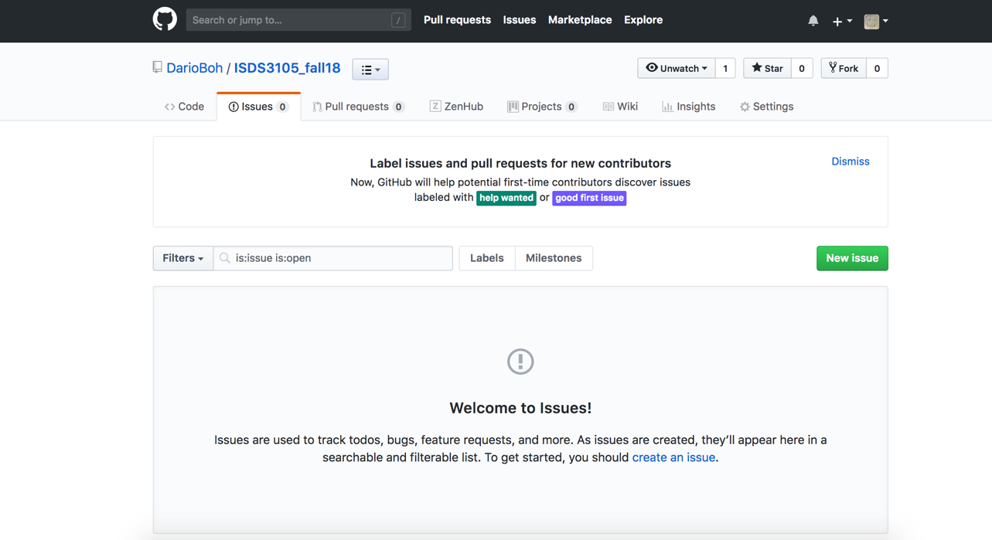
Open an issue when the phrasing is not clear (e.g., misspelling), for gaps in the material, when the code doesn’t work, or when it doesn’t work as expected

Slide 19
RECIPE FOR SUCCESS
Outside of class work
Open mind, patience
Collaboration, team spirit, learn together
Ideas on improvement

